Slide 1
Intro to
Unit Testing

Slide 2
Terms for Quality Problems
error - a mistake made by a human (in a software development activity)
defect (or fault) - the result of introducing an error into a software artifact (SRS, SDS, code, etc.)
failure - a departure from the required behavior for a system

Slide 3
Testing Fundamentals (1)
Software Testing is a critical element of Software Quality Assurance
It represents the ultimate review of the requirements specification, the design, and the code.
It is the most widely used method to insure software quality.
Many organizations spend 40-50% of development time in testing.

Slide 4
Testing Fundamentals (2)
Testing is concerned with establishing the presence of program defects.
Debugging is concerned with finding where defects occur (in code, design or requirements) and removing them. (fault identification and removal)
Even if the best review methods are used (throughout the entire development of software), testing is necessary.

Slide 5
Testing Fundamentals (3)
Testing is the one step in software engineering process that could be viewed as destructive rather than constructive.
  “A successful test is one that breaks the software.” [McConnell 1993]
A successful test is one that uncovers an as yet undiscovered defect.
Testing can not show the absence of defects, it can only show that software defects are present.
For most software exhaustive testing is not possible.

Slide 6
Testing Steps
Unit
test
Design
specifications
System
functional
requirements
Other
software
requirements
Customer
requirements
specification
User
environment
Unit code
Unit
test
Unit code
.
.
.
Integration
test
Function
test
Performance
test
Acceptance
test
Installation
test
Integrated
modules
Functioning
system
Verified,
validated
software
Accepted
system
Unit
test
SYSTEM
IN USE!
Unit code
[Pfleeger 2001]

Slide 7
Unit Testing
Unit Testing checks that an individual program unit (subprogram, object class, package, module) behaves correctly.
  Static Testing
    testing a unit without executing the unit code
  Dynamic Testing
    testing a unit by executing a program unit using test data
There is some debate about what constitutes a “unit”. Here some common definitions of a unit:
  the smallest chunk that can be compiled by itself
  a stand alone procedure of function
  something so small that it would be developed by a single person

Slide 8
First, unit testing in general
Second, the role of unit testing in test-driven design (TDD)
  Spring 05: We’ve done this already!

Slide 9
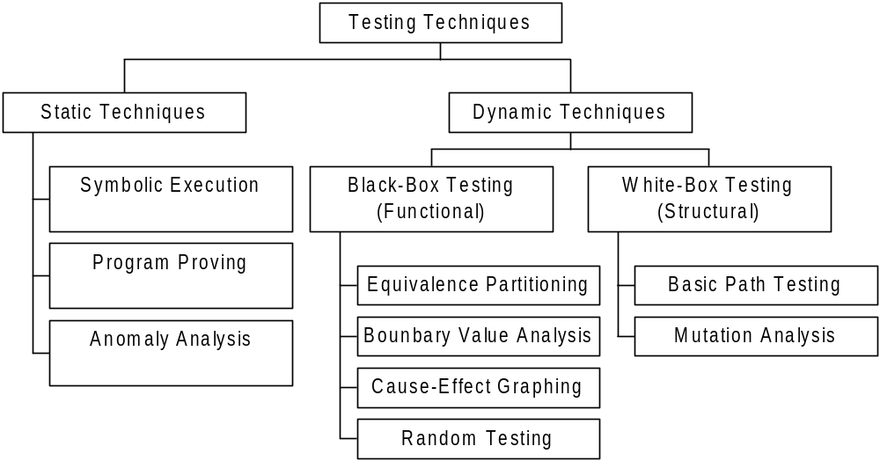
Unit Testing Techniques

Slide 10
Static Testing
Symbolic Execution
  works well for small programs
Program Proving
  difficult and costly to apply
  does not guarantee correctness
Anomaly Analysis
  unexecutable code (island code)
  uninitialized variables
  unused variables
  unstructured loop entry and exit

Slide 11
Dynamic Testing
Black Box Techniques
  design of software tests relies on module description to devise test data
  uses inputs, functionality, outputs in the architectural design
  treats module like a “black box”
White Box Techniques
  design of software tests relies on module source code to devise test data
  analyze the module algorithm in the detailed design
  treats module like a “ white box” or "glass box"

Slide 12
Common Testing Terms (1)
test class
  a set of input data that is identified for testing
  Note difference from JUnit term
test case
  specific data that is chosen for testing a test class.
test Suite
  a set of test cases that serve a particular testing goal
exhaustive testing
  test all logical paths in a software module

Slide 13
Basic Path Testing
Basic Path Testing is a white box testing technique that consists of the following steps:
  convert the unit into a “flow graph”
    A flow graph is a directed graph (for an algorithm) with a "start node" and a "terminal node" (could have multiple terminal nodes, but not ideal).
  compute a measure of the unit's logical complexity
  use the measure to derive a “basic” set of execution paths for which test cases are determined.

Slide 14
Unit Test Planning
Unit test planning is typically performed by the unit developer
Planning of a unit test should take place as soon as possible.
  Black box test planning can take place as soon as the functional requirements for a unit are specified.
  White box test planning can take place as soon as the detailed design for a unit is complete.
Why not wait until a unit is coded and compiled, and ready for execution, before writing the test plan?

Slide 15
Unit Testing Benefits
Developers can work in a predictable way of developing code
Programmers write their own unit tests
Get rapid response for testing small changes
Build many highly-cohesive loosely-coupled modules to make unit testing easier

Slide 16
Testing Tools
There are a number of tools that have been developed to support the testing of a unit or system.
  googling “Software Testing Tools” will yield thousands of results.
JUnit testing (http://www.junit.org/index.htm) is a popular tool/technique that can be integrated into the development process for a unit coded in Java.

